Slide 1
Sociology Course Code (SS 2005)
Muhammad Zeeshan

Slide 2
FAMILY INSTITUTION, ITS TYPES, KINSHIP
The family is a social institution found in all societies that unites people in cooperative groups to care for one another, including an children.
Extended family a family composed of parents and children as well as other kin; also known as a consanguine family
Nuclear family a family composed of one or two parents and their children; also known as a conjugal family
Family ties are also called kinship, a social bond based on common ancestry, marriage, or adoption
Marriage, a legal relationship, usually involving economic cooperation, sexual activity, and childbearing

Slide 3
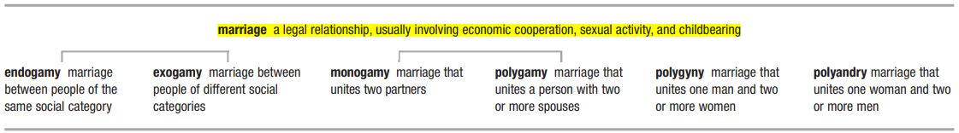
MARRIAGE AND ITS TYPES

Slide 4
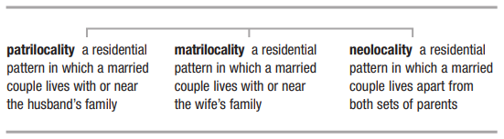
RESIDENTIAL PATTERNS
3 types of resedential patterns in marriage are as under:-

Slide 5
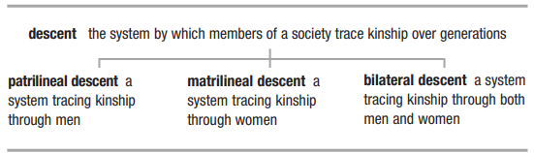
PATTERNS OF DESCENT
3 types of descent patterns in marriage are as under:-

Slide 6
PATTERNS OF AUTHORITY
Patriarchy: A system of male domination where decisions are made by a male member or father in the family.
Matriarchy: A system of female domination where decisions are made by female member or mother in the family.
Egalitarian: A system where both male and female members collectively make decisions in the family.

Slide 7
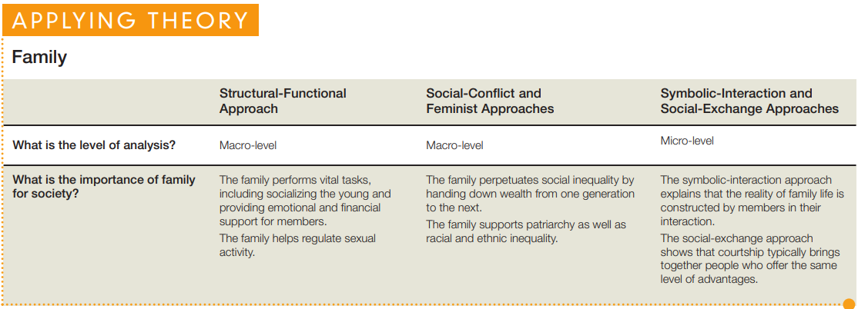

Slide 8
STAGES OF FAMILY LIFE
The family is a dynamic institution. Not only does the family itself change over time, but the way any of us experiences family changes as well as we move through the life course.
New families begin with courtship and evolve as the new partners settle into the realities of married life.
Next, for most couples at least, come the years spent developing careers and raising children,
Leading to the later years of Understand marriage,
After the children have left home to form families of their own.
We will look briefly at each of these four stages.

Slide 9
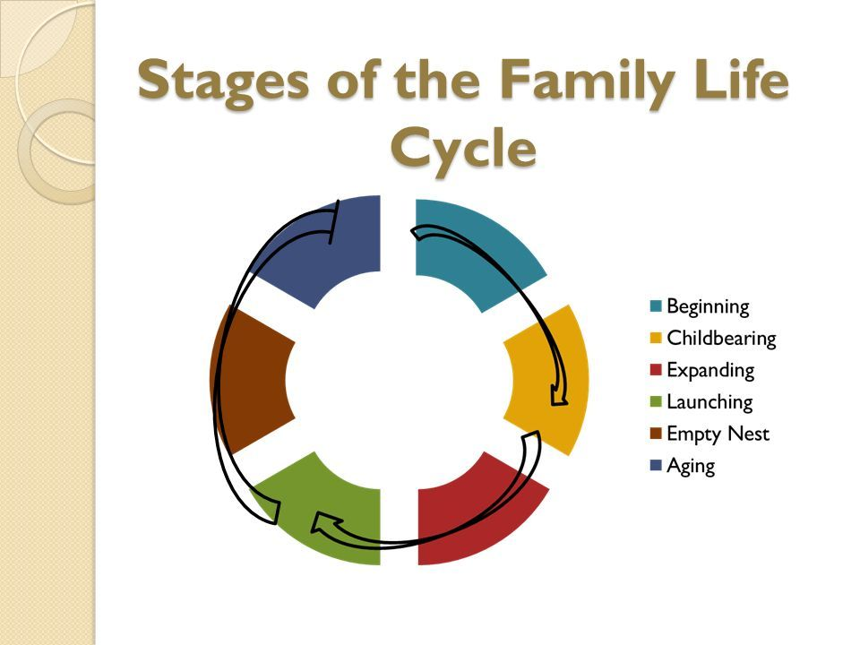
GROUP SIZE

Slide 10
(a) COURTSHIP:-
Arranged marriages
Are alliances between extended families of similar social standing and usually involve an exchange not just of children but also of wealth and favors.
Romantic love has little to do with marriage and parents may make such arrangements when their children are very young.
Because traditional societies are more culturally homogeneous, almost all young men and women have been well socialized to be good spouses.
Therefore, parents can arrange marriages with little thought about whether or not the two individuals involved are personally compatible because they know that the partners will be culturally compatible.
However Industrialization has both eroded the importance of extended families and weakens tradition. As young people begin the process of choosing their own mate, dating sharpens courtship skills and allows sexual experimentation.

Slide 11
1. (b) COURTSHIP
B. Romantic Love
Our culture celebrates romantic love—affection and sexual passion for another person—as the basis for marriage. We find it hard to imagine marriage without love.
Our society’s emphasis on romance motivates young people to “leave the nest” to form new families of their own, and physical passion can help a new couple through the often difficult adjustments of living together (W. J. Goode, 1959).
On the other hand, because feelings change over time, romantic love is a less stable foundation for marriage than social and economic considerations, which is one reason that the divorce rate is much higher in the United States than in nations in which culture is a stronger guide in the choice of a partner.
Most people fall in love with others of the same race, of comparable age, and of similar social class.
Our society “arranges” marriages by encouraging homogamy (literally, “like marrying like”), marriage between people with the same social characteristics

Slide 12
2. SETTLING IN: IDEAL AND REAL MARRIAGE
Our culture gives the young an idealized, “happily ever after” picture of marriage.
Such optimism can lead to disappointment, especially for women, who are taught to view marriage as the key to personal happiness.
Also, romantic love involves a good deal of fantasy: We fall in love with others not always as they are but as we want them to be.
Sexuality, too, can be a source of disappointment.
In the romantic haze of falling in love, people may see marriage as an endless sexual honeymoon, only to face realization that sex becomes a less-than-all-consuming passion.
Although the frequency of marital sex does decline over time, about two in three married people report that they are satisfied with the sexual dimension of their relationship.
In general, couples with the best sexual relationships experience the most satisfaction in their marriages. Sex may not be the key to marital bliss, but more often than not, good sex and good relationships usually go together (Laumann et al., 1994; T. W. Smith, 2006).
Infidelity—sexual activity outside one’s marriage—is another area where the reality of marriage does not match our cultural ideal.

Slide 13
3. CHILD REARING
Despite the demands children make on us, adults in this country overwhelmingly identify raising children as one of life’s greatest joys (Wang & Taylor, 2011).
Today, about half of U.S. adults say that two children is the ideal number, and few people want more than three (NORC, 2011:405, 2317).
This is a change from two centuries ago, when eight children was the average.
Big families pay off in preindustrial societies because children supply needed labor.
People therefore regard having children as a wife’s duty, and without effective birth control, childbearing is a regular event.
Of course, a high death rate in preindustrial societies prevents many children from reaching adulthood; as late as 1900, one-third of children born in the United States died by age ten.
Economically speaking, industrialization transforms children from an asset to a liability. It now costs almost $300,000 to raise one child including college tuition (Lino,2010).
No wonder the average size of the U.S. family dropped steadily during the twentieth century to one child per family.
The trend toward smaller families is most evident in high-income nations.

Slide 14
4. THE FAMILY IN LATER LIFE
Increasing life expectancy in the United States means that couples who remain married will stay together for a long time.
By about age sixty, most have finished the task of raising children.
At this point, marriage brings a return to living with only a spouse.
Like the birth of children, their departure—creating an “empty nest”—requires adjustments, although a marriage often becomes closer and more satisfying.
Years of living together may have lessened a couple’s sexual passion, but understanding and commitment often increase.
Personal contact with children usually continues because most older adults live a short distance from at least one of their children.
One-third of all U.S. adults (56 million) are grandparents. Most grandparents help with child care and other responsibilities.
Among African Americans, who have a high rate of single parenting, grandmothers have an especially important position in family life (U.S. Census Bureau, 2006; AARP Foundation, 2007).
The other side of the coin is that more adults in midlife now care for aging parents.

Slide 15
5. DEATH OF A SPOUSE
The final and surely the most difficult transition in married life comes with the death of a spouse.
Wives typically outlive their husbands because of their greater life expectancy and the fact that women usually marry men several years older than themselves.
Wives can thus expect to spend some years as widows.
The challenge of living alone following the death of a spouse is especially great for men, who usually have fewer friends than widows and may lack housekeeping skills.

Slide 16
TRANSITIONS AND PROBLEMS IN FAMILY LIFE
Divorce:
Separation of married partners due to any specific reasons mentioned below.
Individualism is on the rise
Romantic love fades
Women are less dependent on men
Many of today’s marriages are stressful
Divorce has become socially acceptable
Legally, a divorce is easier to get

Slide 17
Remarriage and Blended Families
Three out of four people who divorce remarry, most within four years.
Nationwide, more than one-third of all new marriages are now remarriages for at least one partner. Men, who benefit more from wedlock, are more likely than women to remarry (U.S. Census Bureau, 2007).
Remarriage often creates blended families, composed of children and some combination of biological parents and stepparents.
With brothers, sisters, half-siblings, a stepparent—not to mention a biological parent who may live elsewhere and be married to someone else with other children—young people in blended families face the challenge of defining many new relationships and deciding just who is part of the nuclear family. Parents often have trouble defining responsibilities for household work among people unsure of their relationships to each other.
When the custody of children is an issue, ex-spouses can be an unwelcome presence for people in a new marriage.
Although blended families require that members adjust to their new circumstances, they offer both young and old the chance to relax rigid family roles (Furstenberg & Cherlin, 2001; McLanahan, 2002).

Slide 18
Family Violence (1/2)
The ideal family is a source of pleasure and support. However, the disturbing reality of many homes is family violence, emotional, physical, or sexual abuse of one family member by another.
There are two types of family violence.
Violence against Women
Emotional, physical and sexual abuse of women by male members of the family is violence against women.
Another form of this violence is known as Marital Rape.
Historically, the law defined wives as the property of their husbands, so no man could be charged with raping his wife.
Today, however, all states have enacted marital rape laws. The law no longer regards domestic violence as a private family matter; it gives victims more options.
Now, even without a formal separation or divorce, a woman can obtain court protection from an abusive spouse, and all states have “stalking laws” that forbid one ex-partner from following or otherwise threatening the other.

Slide 19
Family Violence (2/2)
2. Violence against Children
Violence against children by any family member.
Family violence also victimizes children.
Child abuse entails more than physical injury; abusive adults misuse power and trust to damage a child’s emotional well-being in ways that may last a lifetime.
Child abuse and neglect are most common among the youngest and most vulnerable children
Although child abusers conform to no simple stereotype, they are slightly more likely to be women (54 percent) than men (46 percent). But almost all abusers share one trait—having been abused themselves as children.
Research shows that violent behavior in close relationships is learned; in families, violence begets violence (S. Levine, 2001; U.S. Department of Health and Human Services, 2010).

Slide 20
Alternative Family Forms
One-Parent Families • The proportion of one-parent families— now 30% of all families in the United States—more than doubled during the last generation. • Single parenthood increases a woman’s risk of poverty, which puts children at a disadvantage.
Cohabitation • The sharing of a household by an unmarried couple. Almost half of all people 25 to 44 years of age have cohabited at some point. • Research shows that children born to cohabiting couples are less likely to live with both biological parents until age 18 than children born to married parents.
Gay and Lesbian Couples • Although only Massachusetts, Connecticut, Vermont, New Hampshire, Iowa, New York, and the District of Columbia allow same-sex marriage, many gay men and lesbians form long-lasting relationships and, increasingly, are becoming parents.
Singlehood • One in four households today—up from one in ten in 1950—contains a single person. • The number of young women who are single is rising dramatically, a result of women’s greater participation in the workforce and lessened dependence on men for material support.

Slide 21
Q&A Session

